Slide 1
Harold Pulcher
Senior Consultant and Microsoft MVP

Slide 2
Upcoming Virtual Training Courses
Acceptance & Test-Driven Development Course November 17-19
The Acceptance & Test-Driven Development course is three-day instructor-led course simulates true agile development by mapping user stories to acceptance tests to test-first unit tests through realistic examples and exercises.
Object-Oriented Design with Test-Driven Development December 15-18
The Object-Oriented Design with Test-Driven Development course is four-day instructor-led course introduces the object-oriented design fundamentals, principles and heuristics using Test Driven Development (TDD) that allow us to create robust regression tests and good code.
PSPO November 10-11
The Professional Scrum Product Owner (PSPO) certification course is a 2-day course where participants learn how to leverage Scrum to maximize the value of products and services.
For more information or to sign-up, visit:
www.improving.com/training

Slide 3

Open Positions
1
Web Application Designer, exp with JavaScript and RESTful Web Services
5
SQL Database Developer: Location DFW
Sr Program Manager: Location DFW
Software Engineer in Test: Location DFW
2
6
3
DevOps Engineer with AWS and Terraform exp: Location DFW
7
Full Stack Java Developer: Location DFW
4
ETL Developer with Pentaho and SSIS exp: Location DFW
Location: DFW
Resumes to careers@improving.com
Improving.com/careers

Slide 4
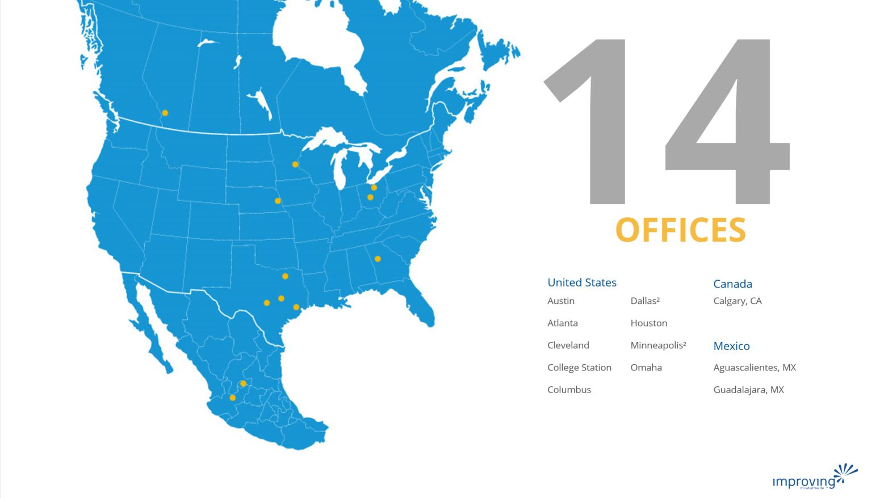
Share details about an upcoming event, conference, user group, booth raffel ect here.

Slide 5

Training class advertisement here​
For details around upcoming training courses available, please check with your local business development managers/office leadership
Fridays at 12pm CST
See past talks on our YouTube Page
https://bit.ly/2Rd0WC5

Slide 6

Harold Pulcher (MVP) @haroldpulcher harold.pulcher@improving.com
https://youtube.com/user/hpulcher https://twitch.tv/haroldpulcher
http://bit.ly/improvingBlazorIntro

Slide 7
Agenda:
What is Blazor?
Getting Started
New Features in Blazor WebAssembly
What’s Next
Fun Stuff!

Slide 8




https://...
JS

Slide 9
INTERACTIVE WEB UI FOR .NET
A BIGGER APP ON WEBASSEMBLY

Slide 10
Why you should be interested in this?
C# Language
Tooling / IDE
Consistent ecosystem
Stability

Slide 11



https://...
DOM
Client-side
(Blazor WebAssembly)

Slide 12
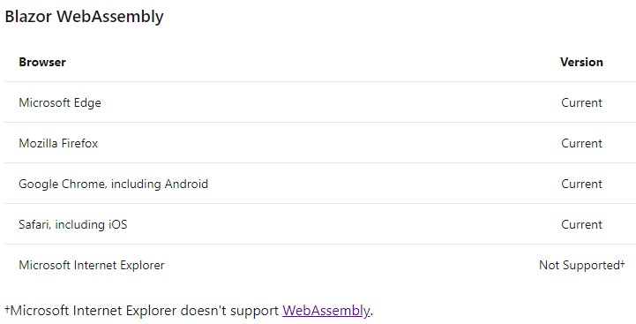

Slide 13


https://...
https://...
SignalR
DOM
DOM
Client-side
(Blazor WebAssembly)
Server-side
(Blazor Server)

Slide 14
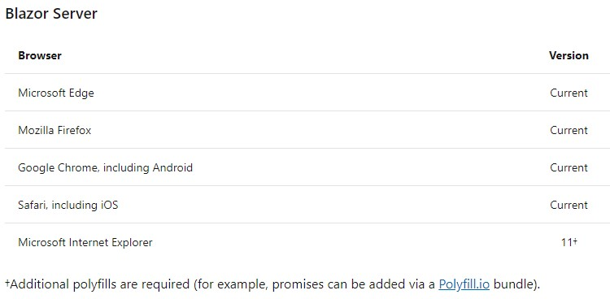

Slide 15
Client-side
(Blazor WebAssembly)
Server-side
(Blazor Server)
Shipped
Released in .NET Core 3.1
Shipped
Released in .NET Core 3.0
Great for:
- Offline support / PWA
- Zero latency UI
- Static-files hosting
Great for:
- Thin client
- Full runtime
- All code on server

Slide 16
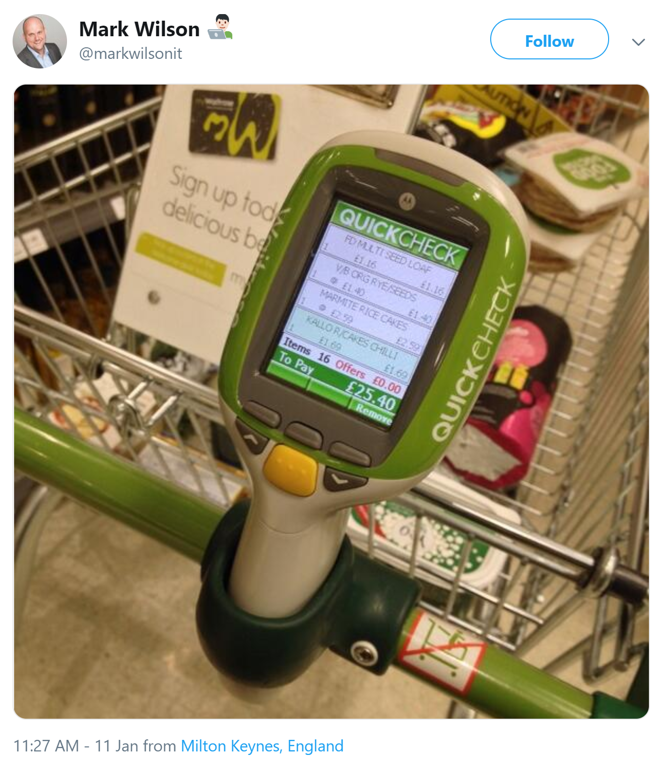

Slide 17
Get Started
Pick your tool of choice: Visual Studio 2019, Visual Studio Code, or Visual Studio for Mac, Visual Studio 2019 Preview RC 4
Install .NET Core 3.1 SDK: dot.net/get-core3, .NET 5.0 RC 2
For Webassembly:
For Server:
dotnet new blazorwasm -o blazor-wasm1
cd blazor-wasm1
dotnet run
dotnet new blazorserver -o blazor-server1
cd blazor-server1
dotnet run

Slide 18
Let’s see this in action!

Slide 19


Authorization
Code sharing

Slide 20


JavaScript interop
Debugging

Slide 21

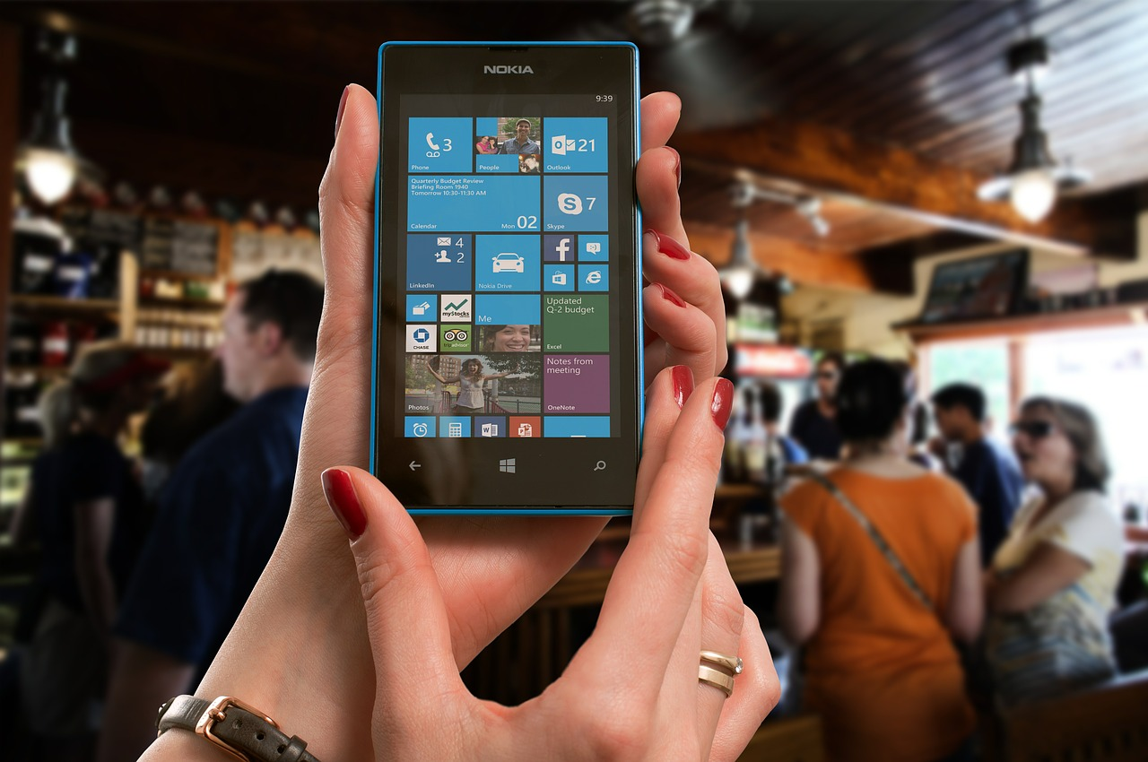
Progressive
Internationalization
Web Apps

Slide 22
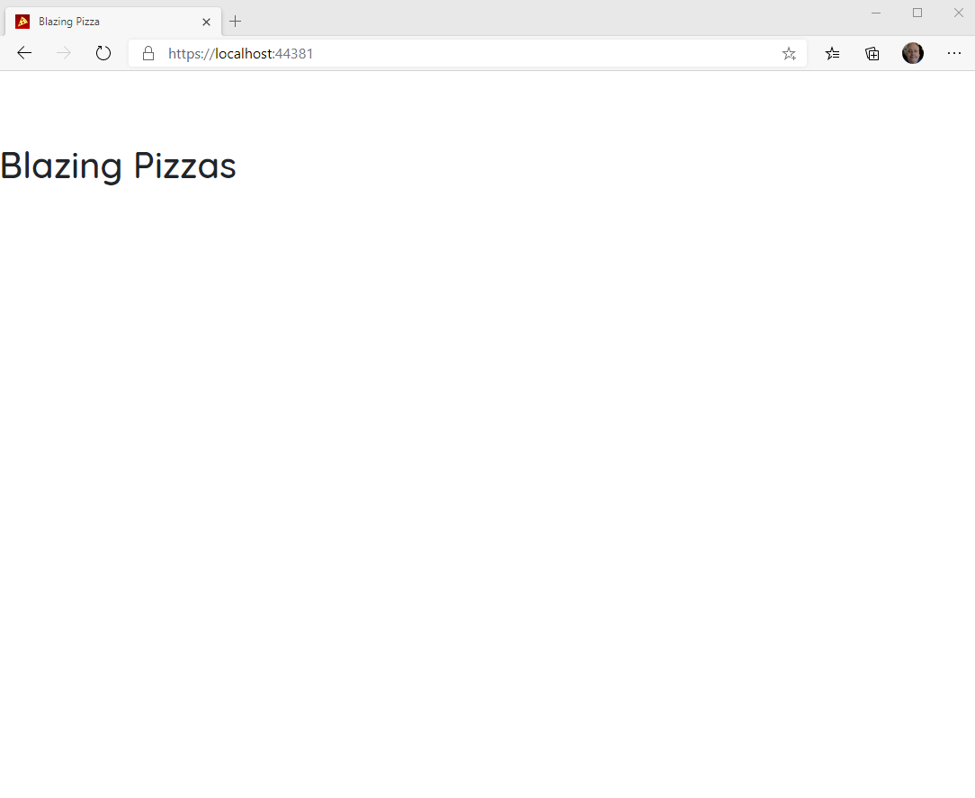
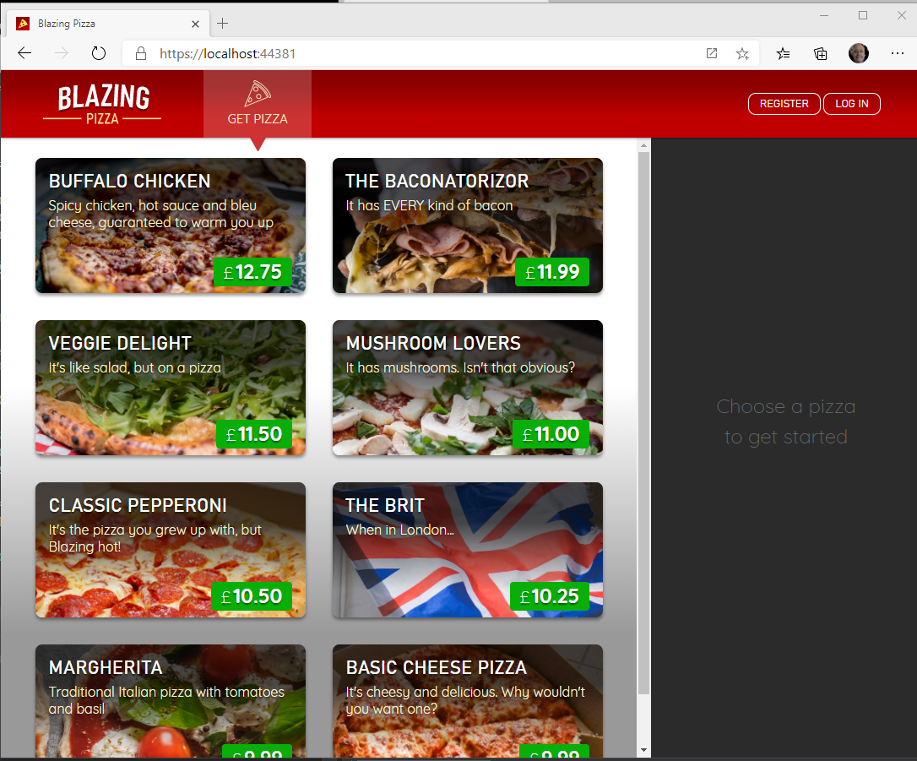

Blazor Workshop
Just Do It!!!!
https://github.com/dotnet-presentations/blazor-workshop

Slide 23
Client-side
(Blazor WebAssembly)
Server-side
(Blazor Server)
Shipped
Released in .NET Core 3.1
Shipped
Released in .NET Core 3.0
Blazor Hybrid
(Desktop app with web rendering)
Blazor + Native UI
(Mobile/desktop with native OS UI)
Uncommitted. Samples:
aka.ms/blazor-electron aka.ms/webwindow
Uncommitted. Samples: aka.ms/mobile-blazor-bindings

Slide 24

What’s next?
Blazor in .NET 5 (Build + Runtime)
Component API Enhancements:
Type constraints, Required Parameters…..
SVG
CSS Isolation
WebAssembly Specific
Multithreaded Runtime
Lazy-Loading

Slide 25
My Asks:
Head over to http://blazor.net and give it a go
Checkout https://aka.ms/blazor-carchecker
Do the workshop!
Send me some feedback: harold.pulcher@improving.com
Follow me on Twitch: @haroldpulcher

Slide 26
Links and stuff
Steve Sanderson Video (used the start of this) presentation: https://www.youtube.com/watch?v=Khn7sDUSEJM
Webassembly base information: https://webassembly.org/
Blazor Getting Started: https://docs.microsoft.com/en-us/aspnet/core/blazor/get-started?view=aspnetcore-3.1&tabs=visual-studio
Blazor Templates: https://www.nuget.org/packages/Microsoft.AspNetCore.Blazor.Templates/
Blazor Routing: https://docs.microsoft.com/en-us/aspnet/core/blazor/routing?view=aspnetcore-3.1
Blazor Workshop: https://github.com/dotnet-presentations/blazor-workshop
WebWindow: https://github.com/SteveSandersonMS/WebWindow
.Net Conf: Focus on Blazor: https://channel9.msdn.com/Events/dotnetConf/Focus-on-Blazor
Basteroids: https://aesalazar.github.io/AsteroidsWasm/
Blazor Pacman: https://pacmanblazor.azurewebsites.net/
* All images are personal or obtained from the “free” section of pixabay.com

Slide 28
WITH
FUTURE
FEATURES
INTERACTIVE WEB UI FOR .NET
A BIGGER APP ON WEBASSEMBLY

Slide 29
WITH
FUTURE
FEATURES
A BIGGER APP ON WEBASSEMBLY
BLAZOR EVERYWHERE
gRPC
Testing
PWA

Slide 30
WITH
FUTURE
FEATURES
A BIGGER APP ON WEBASSEMBLY
BLAZOR EVERYWHERE
gRPC
Testing
PWA

Slide 31

LEARN MORE & GET STARTED
blazor.net
Steven Sanderson
@StevenSanderson

Slide 32
Code sharing

Slide 33
JavaScript interop

Slide 34
Debugging

Slide 35
Internationalization

Slide 36
Progressive Web Apps

Slide 37
LEARN MORE & GET STARTED
blazor.net
CODE & SLIDES
aka.ms/sanderson-london-2020
== https://github.com/SteveSandersonMS/presentation-2020-01-NDCLondon
Steven Sanderson
@StevenSanderson

Slide 38

1
2
3
PIN
* * * *
CART
Item 1
£3.95
Item 2
£12.00
Total: £15.95
0000 0000 0000 0000

